Slide 1

Code based Crypto in the NIST competition
PQC Standardization Process
Ray Perlner

Slide 2
NIST Crypto Standards
Areas:
  Block ciphers, hash functions, message authentication codes (MACs), digital signatures, key-establishment, post-quantum (signatures + key establishment), random bit generation, etc.
FIPS, SPs, and NISTIRs
NISTIR 7977 – NIST’s process for developing crypto standards
  Cooperation with other SDOs
Principles:
  Transparency, openness, balance, integrity, technical merit, global acceptability, usability, continuous improvement, innovation and intellectual property
Stakeholders:
  Primarily the US Federal Government, broader industry and public/private organizations

Slide 3
NIST Competitions*
Block Cipher
  AES – 15 candidates, 2 rounds, 5 finalists, 3 years + 1 year for standard
Hash Function
  SHA-3 – 64 submissions, 51 accepted, 3 rounds, 14 2nd round candidates, 5 finalists, 5 years + 3 years for standard
Post-Quantum Cryptography
  No Name? – 82 submissions, 69 accepted, 2 (or 3) rounds, 26 2nd round candidates, 2017-2020ish + 2? Years for standard
Lightweight Crypto
  57 submissions, 2019-2022ish
Notes:
Time is from announcement to selection of winner

Slide 4

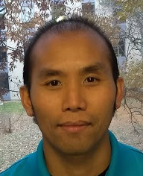


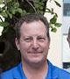
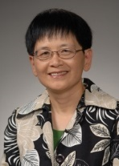



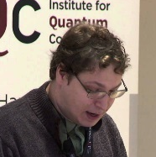


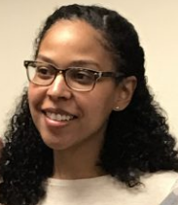
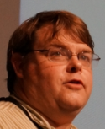
The NIST PQC Project
2009 – NIST publishes a PQC survey
  Quantum Resistant Public Key Cryptography: A Survey [R. Perlner, D. Cooper]
2012 – NIST begins PQC project
  Research and build team
  Work with other standards organizations (ETSI, IETF, ISO/IEC SC 27)
April 2015 – 1st NIST PQC Workshop
Notes:
12+ researchers in crypto, quantum information, quantum algorithms
Bi-weekly seminars. Publish results, attend workshops
Raise awareness for government agencies of coming transition
To monitor progress in quantum computers and quantum algorithms.
To find and standardize quantum-resistant alternatives for PKE, key-agreement, and digital signatures.

Slide 5
A competition by any other name
Feb 2016 – NIST Report on PQC (NISTIR 8105)
Feb 2016 – NIST announcement at PQCrypto in Japan
Dec 2016 – Final requirements and evaluation criteria published
Nov 2017 – Deadline for submissions
Scope:
  Digital Signatures (FIPS 186)
  Public-key encryption/KEMs (SP 800-56A and SP 800-56B)
Expected outcome: a few different algorithms

Slide 6
Competition* Timeline
Past
Jan 2018 – First round candidates announced
April 2018 – First PQC Standardization Conference, FAU
(Joint with PQCrypto2018)
Jan 2019 – Second round candidates announced in first round report (NISTIR 8240)
Mar 2019 – Deadline for second round tweaks
Future
May 31, 2019 – Submission Deadline for…
Aug 22-24 2019 – Second PQC Standardization Conference, UCSB
(Joint with Crypto2019)
2020-2022 Possible third round, Draft Standards

Slide 7
Targeted Functionalities/ Security Definitions
Digital Signature
  EUF-CMA up to 2⁶⁴ signature queries
PKE/KEM (first option)
  IND-CCA up to 2⁶⁴ decryption/decapsulation queries
  Necessary in situations requiring key reuse
PKE/KEM (second option)
  IND-CPA
  Needs usage restrictions to prevent key reuse
  May be worth standardizing in addition to IND-CCA schemes if it comes with significant performance benefits

Slide 8
Evaluation Criteria
Security – against both classical and quantum attacks
  NIST asked submitters to focus on levels 1,2, and 3. (Levels 4 and 5 are for very high security)
Performance – measured on various classical platforms
Other properties:
  Drop-in replacements, Perfect forward secrecy, Resistance to side-channel attacks, Simplicity and flexibility, Misuse resistance, etc.
Level | Security Description
I | At least as hard to break as AES128 (exhaustive key search)
II | At least as hard to break as SHA256 (collision search)
III | At least as hard to break as AES192 (exhaustive key search)
IV | At least as hard to break as SHA384 (collision search)
V | At least as hard to break as AES256 (exhaustive key search)
Notes:
These are understood to be preliminary estimates

Slide 9
The 1st Round Candidates
82 submissions received.
69 accepted as “complete and proper” (5 withdrew)
 | Signatures | KEM/Encryption | Overall
Lattice-based | 5 | 21 | 26
Code-based | 2 | 17 | 19
Multi-variate | 7 | 2 | 9
Symmetric-based | 3 |  | 3
Other | 2 | 5 | 7
Total | 19 | 45 | 64

Slide 10
BIG QUAKE
BIKE
CFPKM
Classic McEliece
Compact LWE
CRYSTALS-DILITHIUM
CRYSTALS-KYBER
DAGS
Ding Key Exchange
DME
DRS
DualModeMS
Edon-K
EMBLEM/R.EMBLEM
FALCON
FrodoKEM
GeMSS
Giophantus
Gravity-SPHINCS
Guess Again
Gui
HILA5
HiMQ-3
HK-17
HQC
KCL
KINDI
LAC
LAKE
LEDAkem
LEDApkc
Lepton
LIMA
Lizard
LOCKER
LOTUS
LUOV
McNie
Mersenne-756839
MQDSS
NewHope
NTRUEncrypt
NTRU-HRSS-KEM
NTRU Prime
NTS-KEM
Odd Manhattan
Ouroboros-R
Picnic
Post-quantum RSA Encryption
Post-quantum RSA Signature
pqNTRUSign
pqsigRM
QC-MDPC-KEM
qTESLA
RaCoSS
Rainbow
Ramstake
RankSign
RLCE-KEM
Round2
RQC
RVB
SABER
SIKE
SPHINCS+
SRTPI
Three Bears
Titanium
WalnutDSA
Notes:
Thank submitters

Slide 11
The 1st Round Candidates
82 submissions received.
69 accepted as “complete and proper” (5 withdrew)
 | Signatures | KEM/Encryption | Overall
Lattice-based | 5 | 21 | 26
Code-based | 2 | 17 | 19
Multi-variate | 7 | 2 | 9
Symmetric-based | 3 |  | 3
Other | 2 | 5 | 7
Total | 19 | 45 | 64

Slide 12
First Round Code-Based Submissions
BIG QUAKE
BIKE
Classic McEliece
DAGS
Edon-K
HQC
LAKE
LEDAkem
LEDApkc
Lepton
LOCKER
McNie
NTS-KEM
Ouroboros-R
pqsigRM
QC-MDPC-KEM
RaCoSS
RankSign
RLCE-KEM
RQC

Slide 13
Subcategories
Algebraic
BIG QUAKE
Classic McEliece
DAGS
NTS-KEM
pqsigRM
RLCE-KEM
Short Hamming
BIKE
HQC
LEDAkem
LEDApkc
Lepton
QC-MDPC-KEM
RaCoSS
Low Rank
Edon-K
LAKE
LOCKER
McNie
Ouroboros-R
RQC

Slide 14
Cryptanalysis takes its toll
Algebraic
BIG QUAKE
Classic McEliece
DAGS
NTS-KEM
pqsigRM
RLCE-KEM
Short Hamming
BIKE
HQC
LEDAkem
LEDApkc
Lepton
QC-MDPC-KEM
RaCoSS
Low Rank
Edon-K
LAKE
LOCKER
McNie
Ouroboros-R
RankSign
RQC

Slide 15
Cryptanalysis takes its toll
(The code-based signatures did not make it ☹)
Algebraic
BIG QUAKE
Classic McEliece
DAGS
NTS-KEM
pqsigRM
RLCE-KEM
Short Hamming
BIKE
HQC
LEDAkem
LEDApkc
Lepton
QC-MDPC-KEM
RaCoSS
Low Rank
Edon-K
LAKE
LOCKER
McNie
Ouroboros-R
RankSign
RQC

Slide 16
Cryptanalysis takes its toll
(The Survivors)
Algebraic
BIG QUAKE
Classic McEliece
NTS-KEM
Short Hamming
BIKE
HQC
LEDAkem
LEDApkc
QC-MDPC-KEM
Low Rank
LAKE
LOCKER
Ouroboros-R
RQC

Slide 17
Submissions merge;
NIST narrows down for 2nd round.
Algebraic
Classic McEliece
NTS-KEM
Short Hamming
BIKE
HQC
LEDAcrypt
Low Rank
ROLLO
RQC

Slide 18
Algebraic Codes
2nd round representatives:
  Classic McEliece
  NTS-KEM

Slide 19
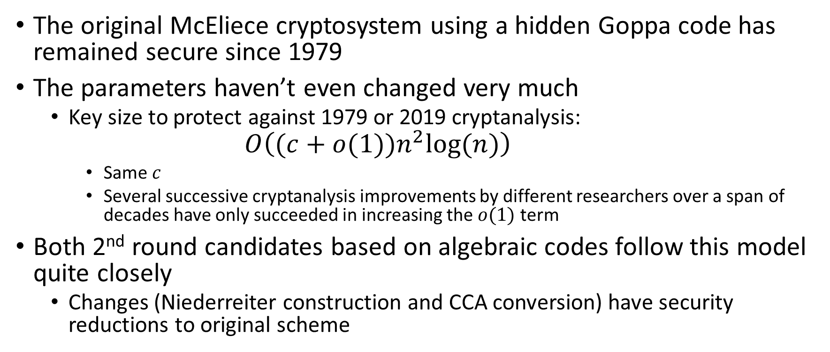
The Original Algebraic Code-Based Cryptosystem
(Goppa McEliece)
The original McEliece cryptosystem using a hidden Goppa code has remained secure since 1979
The parameters haven’t even changed very much
  Key size to protect against 1979 or 2019 cryptanalysis:
    $$O\left((c+o(1))n^{2}log⁡(n)\right)$$
    Same $c$
    Several successive cryptanalysis improvements by different researchers over a span of decades have only succeeded in increasing the $o(1)$ term
Both 2nd round candidates based on algebraic codes follow this model quite closely
  Changes (Niederreiter construction and CCA conversion) have security reductions to original scheme

Slide 20
Other Algebraic Codes
GRS codes:
  Broken by [Sidelnikov, Shestakov 1992]
  Patched version broken by [Wieschebrink 2005]
  Further patched version broken by [Couvreur, Gaborit, Gauthier-Umaña, Otmani, Tillich 2013]
  NIST submission (RLCE) partially broken by [Couvreur, Lequesne, Tillich 2018]
Gabidulin codes:
  Broken by [Gibson 1996]
Reed Muller codes:
  Broken by [Minder, Shokrollahi 2007]
  Further broken by [Chizhov, Borodin 2013]
  Submitted patched version (pqSigRM) broken by NIST researchers
  [Alperin-Sheriff, Moody, Perlner (PQC forum 2018)]

Slide 21
Key Size Reduction
The original McEliece cryptosystem has decent performance and good ciphertext size, but its public key size is enormous!
Idea: adapt ring-based key-size reduction techniques developed for lattices starting with NTRU
This idea has often interacted badly with algebraic codes
  Structural cryptanalysis: [Otmani, Tillich, Dallot 2008]
  Algebraic cryptanalysis: [Faugere, Otmani, Perret, Tillich 2010]
  Folded code attack: [Faugere, Otmani, Perret, Portzamparc, Tillich 2016]
  NIST submission DAGS broken by [Barelli, Couvreur 2018]

Slide 22
Key Size Reduction (Continued)
NIST submission BigQuake applied key size reduction to a Goppa code
It was not broken but:
  Key size is still worse than completely unstructured lattice KEMs
  Hard to see BigQuake as a safe fallback option
    Unstructured Goppa McEliece has remained pretty much intact since 1979
    Cryptanalysis of QC Goppa McEliece has changed dramatically as recently as 2016
  NIST ultimately did not select it for the second round

Slide 23
Is Goppa McEliece good or just lucky?
Unstructured Goppa McEliece is considered a conservative choice due to its longevity
Still questions remain
  Is there any strong theoretical reason why Goppa codes are safe but e.g. GRS codes are not?
  Strong security argument if disguised Goppa codes is indistinguishable from a random code
    But there are known distinguishers for some (unusual) parameters:
    [Faugere, Gauthier-Umaña, Otmani, Perret, Tillich 2010]
  Some tools for answering (e.g. square code dimension)
    Do we have the full picture?

Slide 24
Algebraic Codes Summary
Long history of cryptanalysis
Originally proposed unstructured Goppa codes have survived pretty much intact
Other algebraic codes, key size reduction attempts have often led to trouble
2nd round candidates Classic McEliece and NTS-KEM offer
  Good ciphertext size
  No decryption failures
  Remarkable longevity
But
  Very large public keys
  Unclear explanation for longevity

Slide 25
Non-Algebraic codes
Can be seen as a generalization of lattice-based cryptography where Euclidean metric is replaced by either:
  Hamming metric (BIKE, HQC, LEDAcrypt) OR
  Rank metric (ROLLO, RQC)
Constructions are either:
  NTRU-like (BIKE-1,2, LEDAcrypt, ROLLO-1,2) OR
  Ring-LWE-like (BIKE-3, HQC, ROLLO-3, RQC)
Decryption/Decapsulation uses either:
  Private LDPC/MDPC/LRPC decoder (BIKE, LEDAcrypt, ROLLO) OR
  Decoder for a public code (HQC, RQC)

Slide 26
Non-Algebraic Constructions Summary
 | Private Decoder |  | Public Decoder
 | NTRU-like | Ring-LWE-like (Ouroboros) | Ring-LWE-like
Hamming Metric | BIKE-1,2 LEDAcrypt | BIKE-3 | HQC
Rank Metric | ROLLO-1,2 | ROLLO-3 | RQC

Slide 27
Lattices and Non-Algebraic Codes
Shared Advantages
Use of rings for key-size reduction is apparently safe
Limited avenues for cryptanalysis
  Known attacks for key recovery, message recovery look the same

Slide 28
Lattices and non-Algebraic codes
Differences
Lattices
Codes
(Non-tight) Search/Decision, Worst/Average case reductions
Complexity of known attacks difficult to quantify
Efficient constructions for signatures
Advanced crypto primitives (e.g. FHE)
No Worst/Average case reductions
  Search/Decision reductions known, but not in ring case
Complexity of known attacks easier to quantify
  Hamming seems better understood than rank at present
  Both provide a hedge against unexpected advances in lattice cryptanalysis
Signature, advanced crypto primitives seem harder to design

Slide 29
Hamming Metric Codes
2nd round representatives:
  BIKE
  HQC
  LEDAcrypt

Slide 30
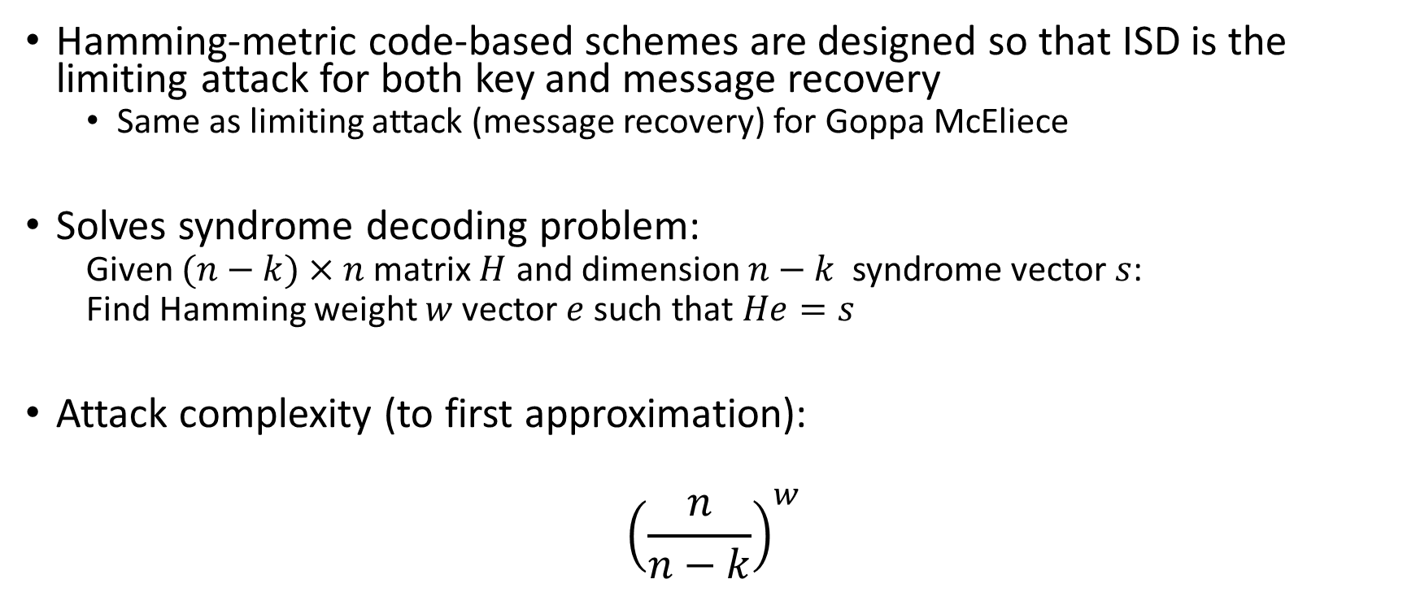
Information Set Decoding (ISD)
Hamming-metric code-based schemes are designed so that ISD is the limiting attack for both key and message recovery
  Same as limiting attack (message recovery) for Goppa McEliece
Solves syndrome decoding problem:
  Given $(n−k)×n$ matrix $H$ and dimension $n−k$ syndrome vector $s$:
  Find Hamming weight $w$ vector $e$ such that $He=s$
Attack complexity (to first approximation):
$${\left(\frac{n}{n−k}\right)}^{w}$$

Slide 31
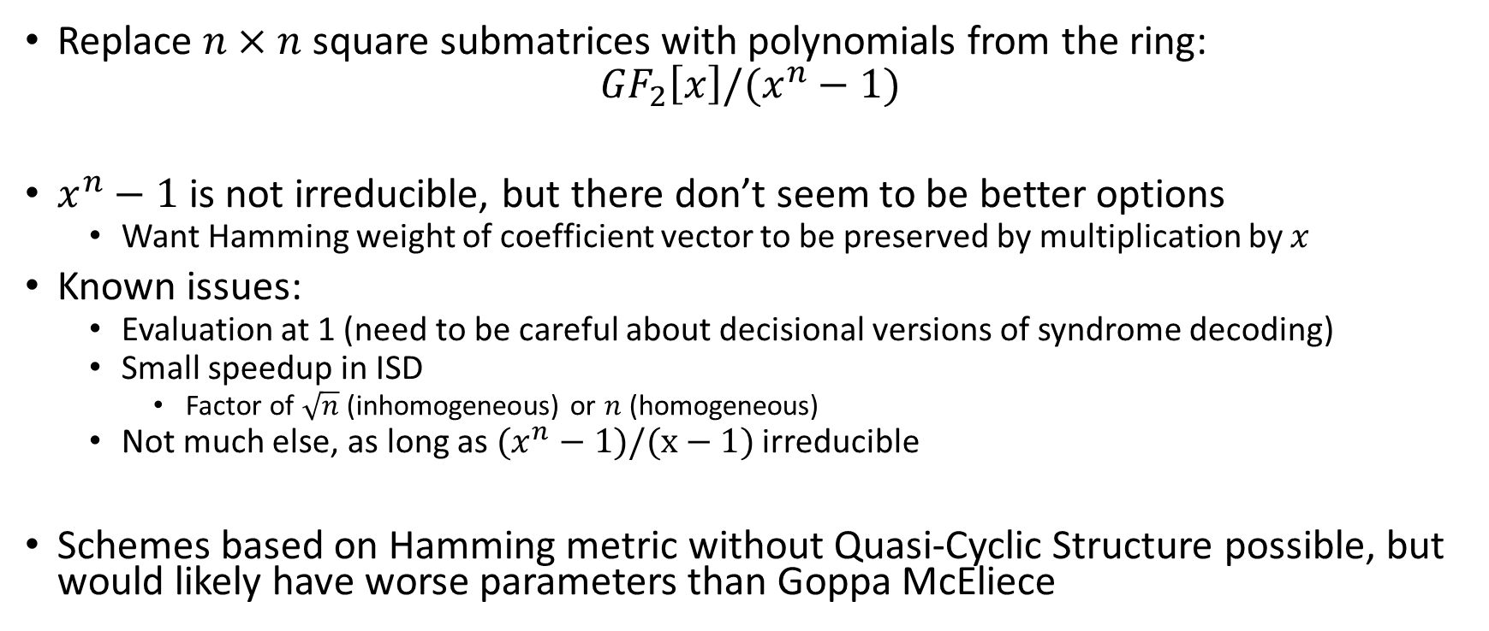
Quasi-Cyclic Structure
Replace $n×n$square submatrices with polynomials from the ring:
$${GF}_{2}\left[x\right]/(x^{n}−1)$$
$x^{n}−1$ is not irreducible, but there don’t seem to be better options
  Want Hamming weight of coefficient vector to be preserved by multiplication by $x$
Known issues:
  Evaluation at 1 (need to be careful about decisional versions of syndrome decoding)
  Small speedup in ISD
    Factor of $\sqrt{n}$ (inhomogeneous) or $n$ (homogeneous)
  Not much else, as long as $(x^{n}−1)/(x−1)$ irreducible
Schemes based on Hamming metric without Quasi-Cyclic Structure possible, but would likely have worse parameters than Goppa McEliece

Slide 32
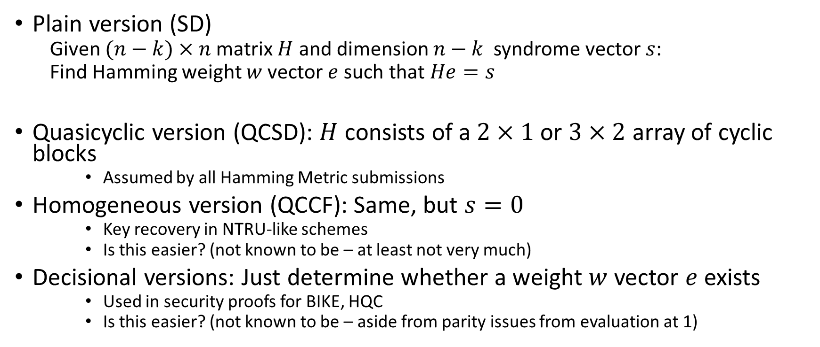
Syndrome decoding (SD) assumptions
Plain version (SD)
  Given $(n−k)×n$ matrix $H$ and dimension $n−k$ syndrome vector $s$:
  Find Hamming weight $w$ vector $e$ such that $He=s$
Quasicyclic version (QCSD): $H$ consists of a $2×1$ or $3×2$ array of cyclic blocks
    Assumed by all Hamming Metric submissions
Homogeneous version (QCCF): Same, but $s=0$
    Key recovery in NTRU-like schemes
    Is this easier? (not known to be – at least not very much)
Decisional versions: Just determine whether a weight $w$ vector $e$ exists
    Used in security proofs for BIKE, HQC
    Is this easier? (not known to be – aside from parity issues from evaluation at 1)

Slide 33
Issue 1: How much does CCA cost?
Round 1 versions of BIKE, LEDAcrypt had too high a dec. failure rate (DFR) for CCA security
Round 1 version of HQC had a low enough DFR and claimed CCA security
  But suffered factor of ~4 penalty in ciphertext and ~2 penalty in public key size (relative to BIKE-2)
Late in Round 1, LEDAcrypt announced a lower DFR
Round 2 versions of both BIKE and LEDAcrypt claim CCA parameter sets with better sizes than HQC
New CCA claims need to be checked by the community

Slide 34
Issue 2: Is homogeneous SD safe?
BIKE-1,2 and LEDAcrypt assume hardness of both homogeneous and inhomogeneous syndrome decoding
BIKE-3 and HQC only need inhomogeneous
  Key and ciphertext sizes not as good, though
Is the distinction in security assumptions sufficient to justify the performance gap?

Slide 35
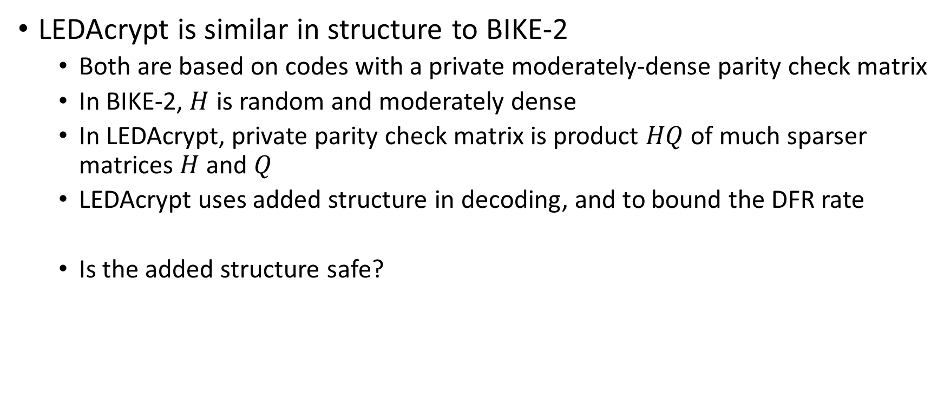
Issue 3: LEDAcrypt extra structure
LEDAcrypt is similar in structure to BIKE-2
  Both are based on codes with a private moderately-dense parity check matrix
  In BIKE-2, $H$ is random and moderately dense
  In LEDAcrypt, private parity check matrix is product $HQ$ of much sparser matrices $H$ and $Q$
  LEDAcrypt uses added structure in decoding, and to bound the DFR rate
  Is the added structure safe?

Slide 36
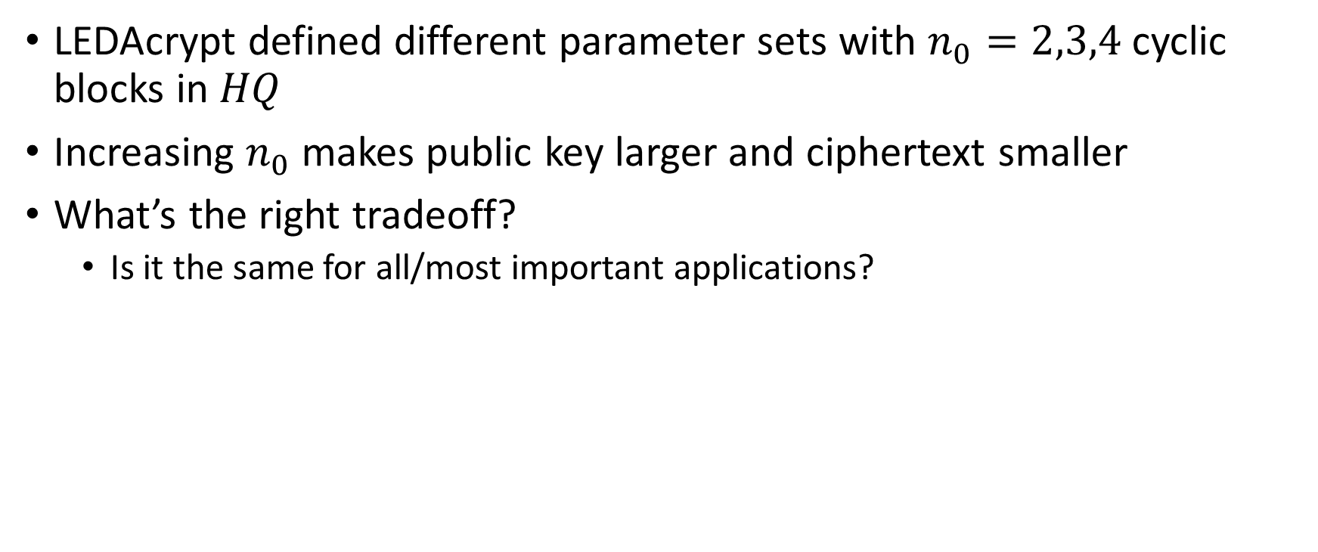
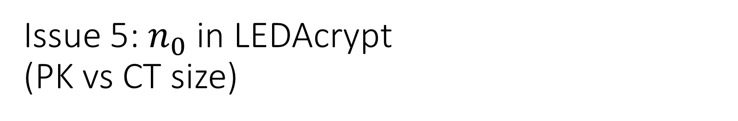
Issue 5: $n_{0}$ in LEDAcrypt
(PK vs CT size)
LEDAcrypt defined different parameter sets with $n_{0}=2,3,4$ cyclic blocks in $HQ$
Increasing $n_{0}$ makes public key larger and ciphertext smaller
What’s the right tradeoff?
  Is it the same for all/most important applications?

Slide 37
Issue 4: BIKE-1 vs BIKE-2
(Computation vs Bandwidth)
BIKE-1 and BIKE-2 have equivalent security
BIKE-1 doubles key and ciphertext size to avoid polynomial division in key generation (slowest operation in BIKE-2)
Note: HQC offers even cheaper operations and more bandwidth
Are the saved CPU cycles worth the bandwidth?
  Is the answer the same for all/most important applications?

Slide 38
Hamming Metric Codes Summary
Quasi-Cyclic Hamming metric codes offer many of the benefits of structured lattices
  Good key size
  (Apparently) only one class of attacks
ISD is well studied, and its concrete complexity is (again, apparently) well understood
Remaining questions for Round 2
  Are CCA claims and DFR estimates correct for round 2 tweaks?
  Do different security assumptions matter, or should we just pay attention to performance? (assuming no further attacks)
  Is bandwidth or computation the bottleneck for these schemes?
  Can the above considerations help us and the submitters narrow down options?

Slide 39
Rank Metric Codes
2nd round representatives:
  ROLLO
  RQC

Slide 40

Rank Metric
Applies to vectors over $GF\left(q^{m}\right)$
  Note: q=2 for all parameter sets
Use a basis over $GF(q)$ to rewrite an $n$-dimensional vector over $GF\left(q^{m}\right)$ as an $n×m$ matrix over $GF(q)$
  Compute the rank
E.g. under the basis $(1,x,x^{2})$ for $GF(2^{3})$:
$$(1+x,0,1+x^{2},1+x,x^{2}+x)$$
becomes
$\left(\begin{matrix}\begin{matrix}\begin{matrix}1 \\ 1 \\ 0\end{matrix} & \begin{matrix}0 \\ 0 \\ 0\end{matrix}\end{matrix} & \begin{matrix}\begin{matrix}1 \\ 0 \\ 1\end{matrix} & \begin{matrix}1 \\ 1 \\ 0\end{matrix} & \begin{matrix}0 \\ 1 \\ 1\end{matrix}\end{matrix}\end{matrix}\right)$
Which has rank 2.

Slide 41
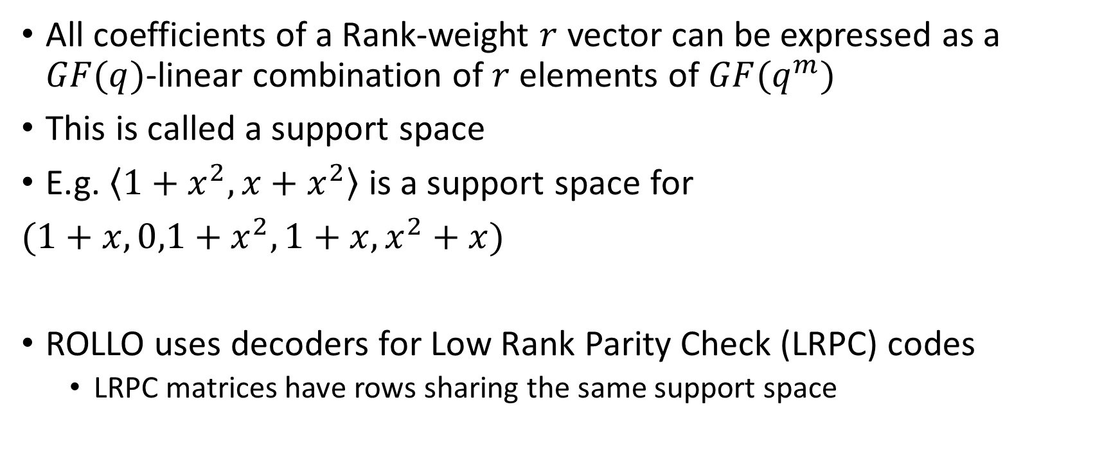
Support Spaces
All coefficients of a Rank-weight $r$ vector can be expressed as a $GF(q)$-linear combination of $r$ elements of $GF(q^{m})$
This is called a support space
E.g. $\left\langle 1+x^{2}, x+x^{2}\right\rangle$ is a support space for
$(1+x,0,1+x^{2},1+x,x^{2}+x)$
ROLLO uses decoders for Low Rank Parity Check (LRPC) codes
  LRPC matrices have rows sharing the same support space

Slide 42
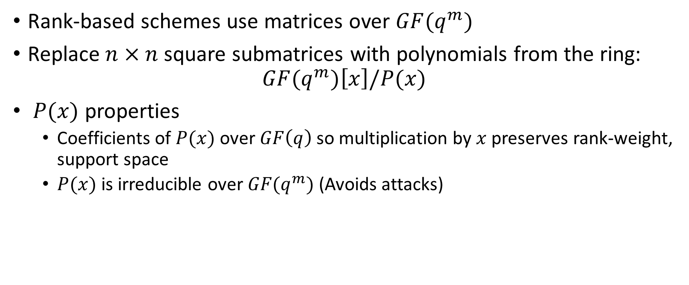
Ideal codes
Rank-based schemes use matrices over $GF(q^{m})$
Replace $n×n$square submatrices with polynomials from the ring:
$$GF(q^{m})\left[x\right]/P(x)$$
$P(x)$ properties
  Coefficients of $P(x)$ over $GF\left(q\right)$ so multiplication by $x$ preserves rank-weight, support space
  $P(x)$ is irreducible over $GF(q^{m})$ (Avoids attacks)

Slide 43
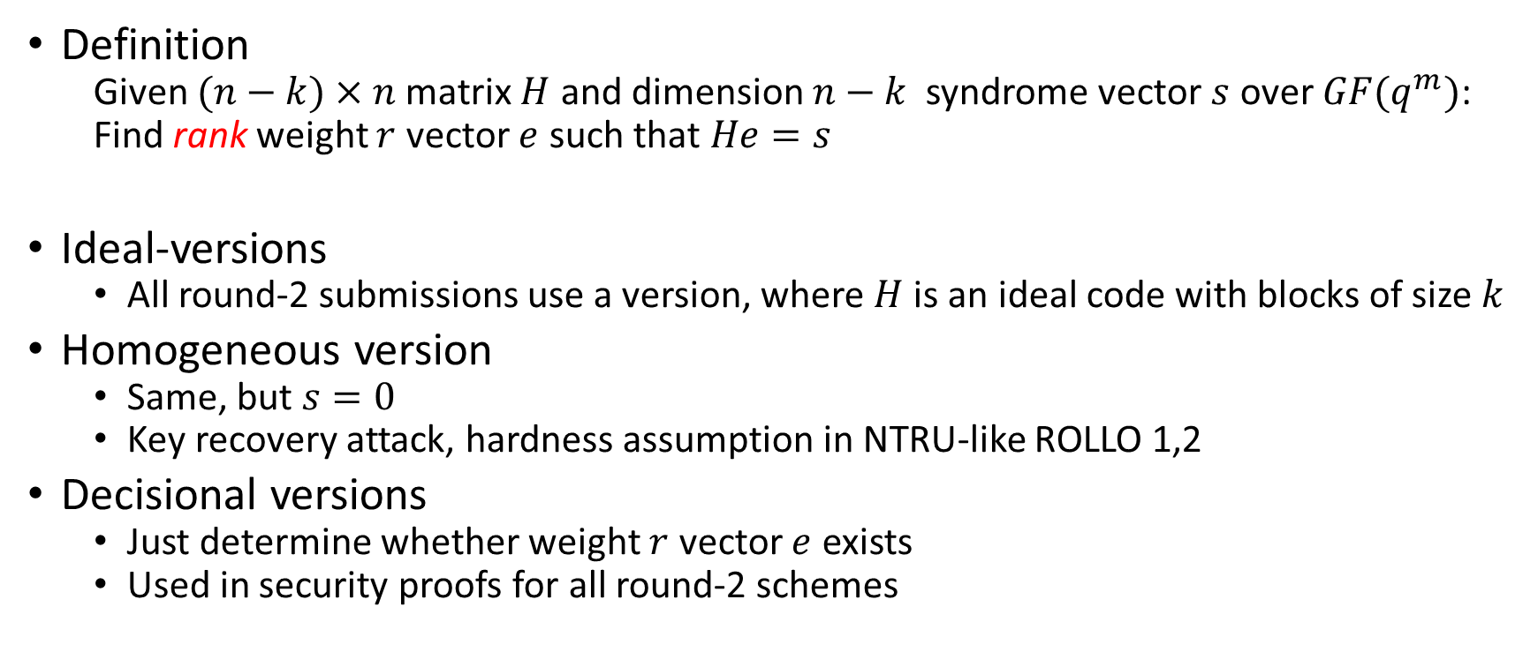
Rank Syndrome Decoding (RSD)
Definition
  Given $(n−k)×n$ matrix $H$ and dimension $n−k$ syndrome vector $s$ over $GF(q^{m})$:
  Find rank weight $r$ vector $e$ such that $He=s$
Ideal-versions
  All round-2 submissions use a version, where $H$ is an ideal code with blocks of size $k$
Homogeneous version
  Same, but $s=0$
  Key recovery attack, hardness assumption in NTRU-like ROLLO 1,2
Decisional versions
  Just determine whether weight $r$ vector $e$ exists
  Used in security proofs for all round-2 schemes

Slide 44
RSD attacks
Almost all published research on RSD is by the authors of ROLLO and RQC
  Needs more study
Parameters are set based on “support trapping” attack
Personal opinion
  RSD looks very closely related to multivariate cryptanalysis techniques (MINRANK in particular)
    Very different parameters, though!
  More interaction with the multivariate community could increase confidence that we know the concrete hardness of RSD problem
  I’m currently working with Baena-Giraldo, Cabarcas-Jaramillo, Khathuria, Smith-Tone, Verbel-Herrera on research in this direction

Slide 45
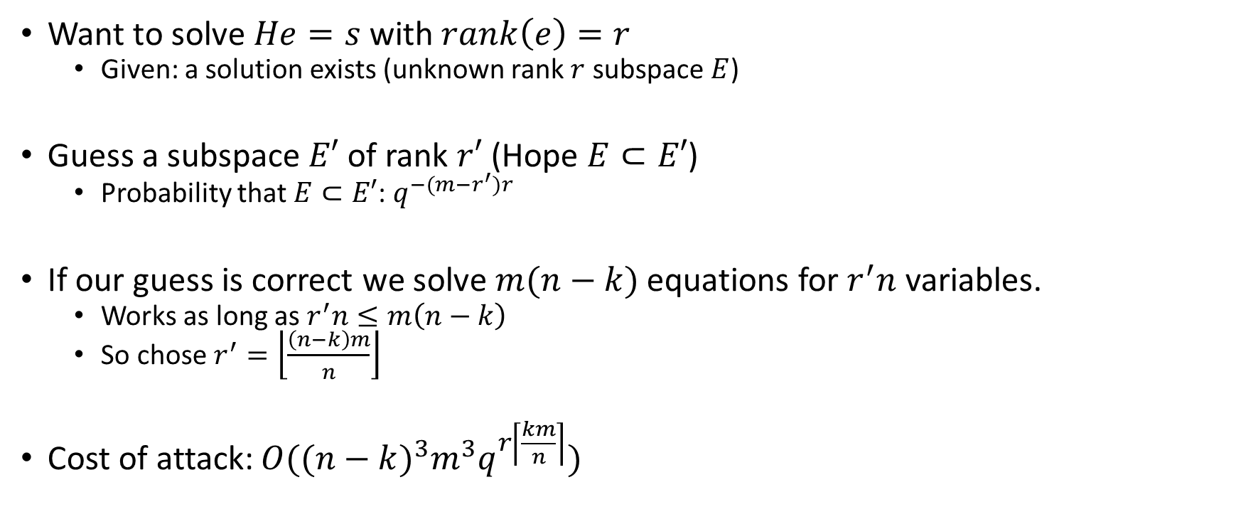
Support Trapping Attack
[Gaborit, Ruatta, Schrek 2013]
Want to solve $He=s$ with $rank\left(e\right)=r$
  Given: a solution exists (unknown rank $r$ subspace $E$)
Guess a subspace$E′$ of rank $r′$ (Hope $E⊂E′$)
  Probability that $E⊂E′$: $q^{−(m−r^{′})r}$
If our guess is correct we solve $m(n−k)$ equations for $r^{′}n$ variables.
  Works as long as $r^{′}n≤m\left(n−k\right)$
  So chose $r^{′}=\left\lfloor \frac{\left(n−k\right)m}{n}\right\rfloor$
Cost of attack: $O({(n−k)}^{3}m^{3}q^{r\left\lceil \frac{km}{n}\right\rceil })$

Slide 46
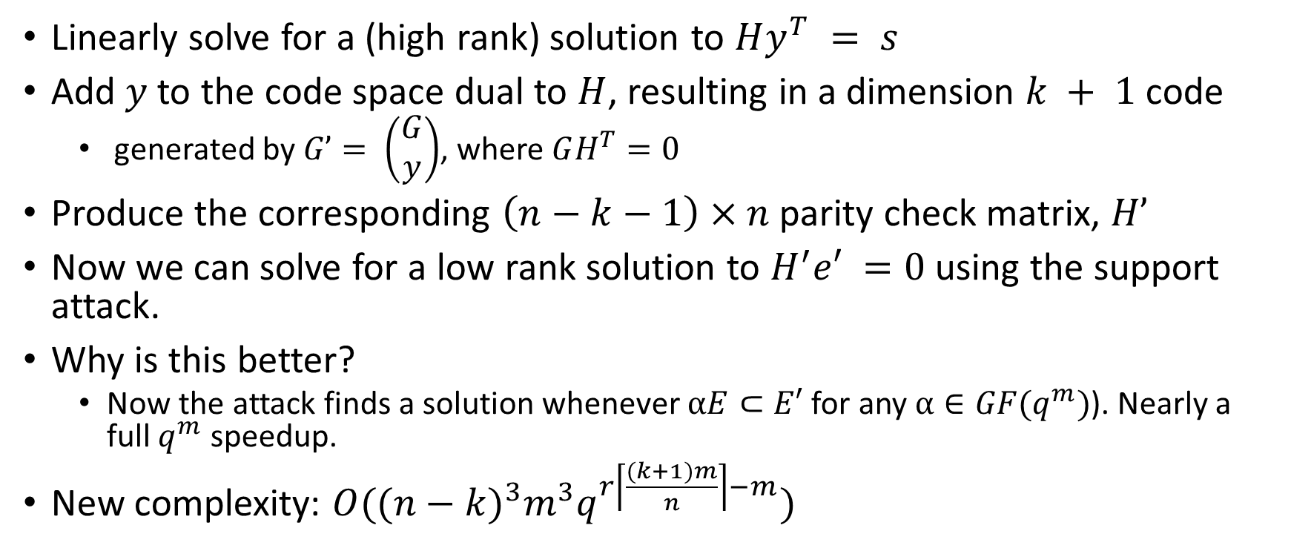
Support Trapping Attack Improved
[Aragon, Gaborit, Hauteville, Tillich 2018]
Linearly solve for a (high rank) solution to $Hy^{T} = s$
Add $y$ to the code space dual to $H$, resulting in a dimension $k + 1$code
  generated by $G’= \left(\begin{matrix}G \\ y\end{matrix}\right)$, where $GH^{T}=0$
Produce the corresponding $\left(n−k−1\right)×n$ parity check matrix, $H’$
Now we can solve for a low rank solution to $H^{′}e′ =0$ using the support attack.
Why is this better?
  Now the attack finds a solution whenever $αE⊂E′$ for any $α∈GF(q^{m})$). Nearly a full $q^{m}$ speedup.
New complexity: $O({(n−k)}^{3}m^{3}q^{r\left\lceil \frac{(k+1)m}{n}\right\rceil −m})$

Slide 47
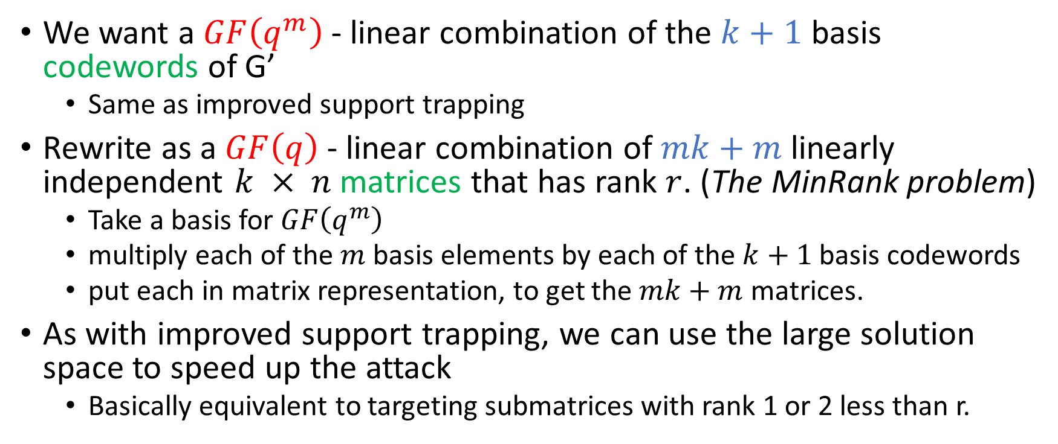
Rank Syndrome Decoding as MinRank
We want a $GF\left(q^{m}\right)$ - linear combination of the $k+1$ basis codewords of G’
  Same as improved support trapping
Rewrite as a $GF\left(q\right)$ - linear combination of $mk+m$ linearly independent $k × n$matrices that has rank $r$. (The MinRank problem)
  Take a basis for $GF\left(q^{m}\right)$
  multiply each of the $m$ basis elements by each of the $k+1$basis codewords
  put each in matrix representation, to get the $mk+m$ matrices.
As with improved support trapping, we can use the large solution space to speed up the attack
  Basically equivalent to targeting submatrices with rank 1 or 2 less than r.

Slide 48
Standard Techniques for MinRank:
1. Linear Algebra Search
Important technique for multivariate scheme, Rainbow
Steps:
  Guess subspace of right or left kernel of target matrix
  If correct, solve linearly for combination of matrices having guessed kernel
  Repeat as necessary
Compare to support trapping:
  Guess space containing row or column space of target matrix
  If correct, solve linearly for combination of matrices having row/column space
  Repeat as necessary
These appear to be dual descriptions of the same attack

Slide 49
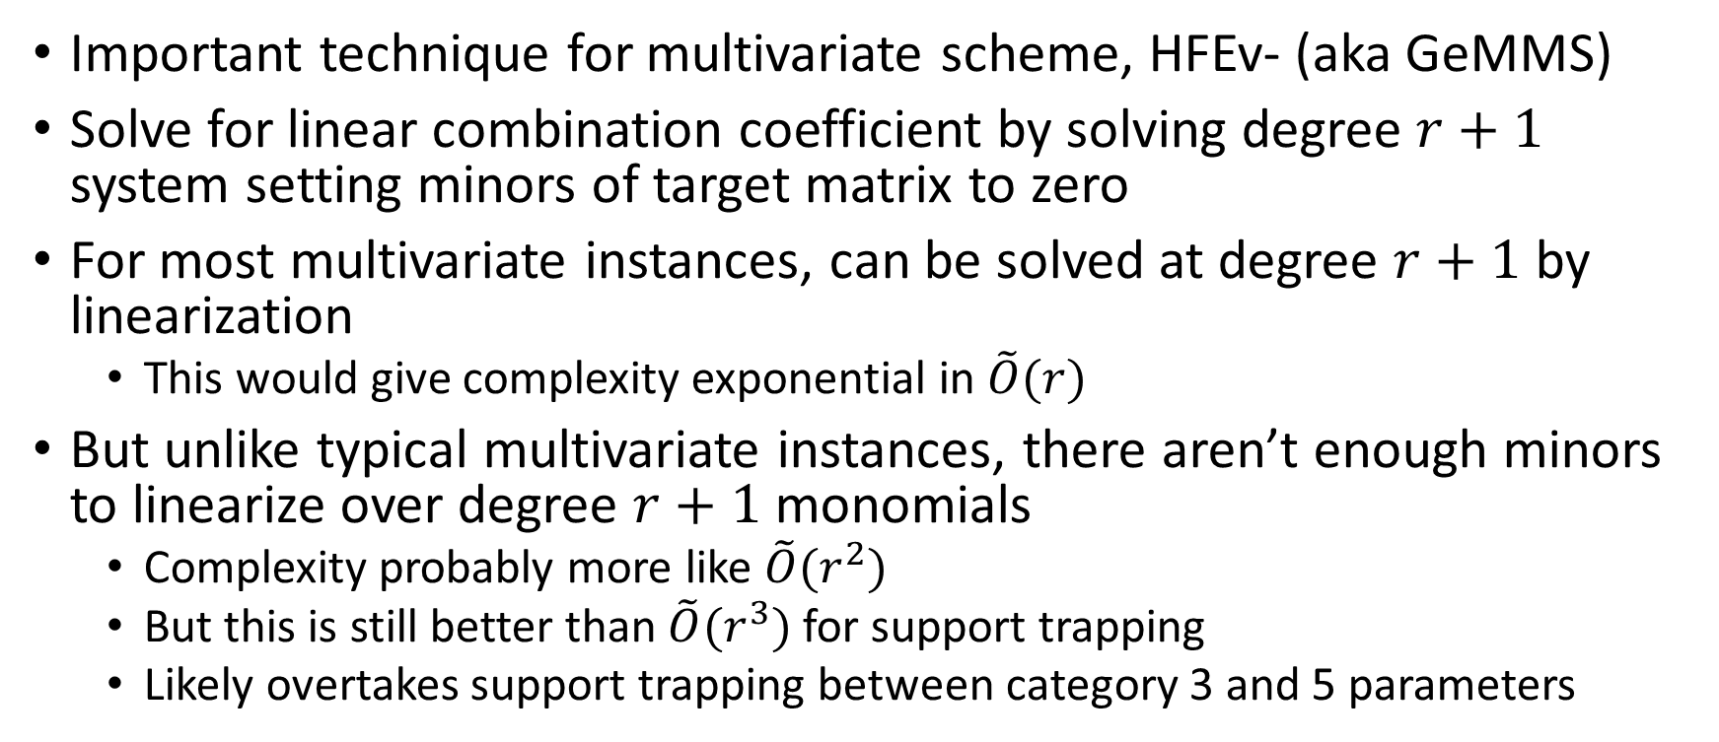
Standard Techniques for MinRank:
2. Minors Modeling
Important technique for multivariate scheme, HFEv- (aka GeMMS)
Solve for linear combination coefficient by solving degree $r+1$ system setting minors of target matrix to zero
For most multivariate instances, can be solved at degree $r+1$ by linearization
  This would give complexity exponential in $\tilde{O}(r)$
But unlike typical multivariate instances, there aren’t enough minors to linearize over degree $r+1$ monomials
  Complexity probably more like $\tilde{O}(r^{2})$
  But this is still better than $\tilde{O}(r^{3})$ for support trapping
  Likely overtakes support trapping between category 3 and 5 parameters

Slide 50
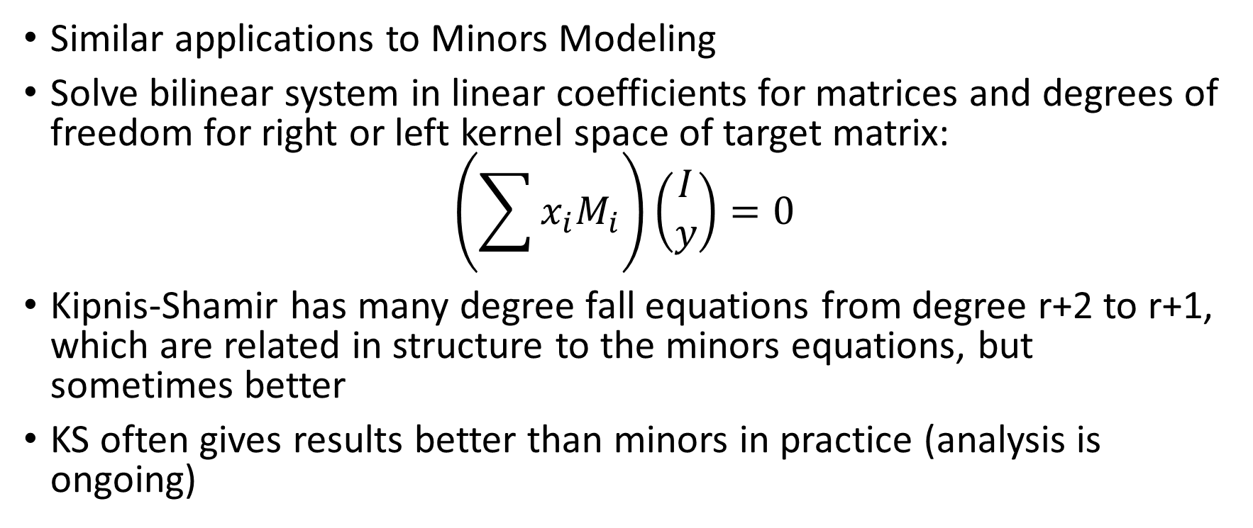
Standard Techniques for MinRank
3. Kipnis-Shamir
Similar applications to Minors Modeling
Solve bilinear system in linear coefficients for matrices and degrees of freedom for right or left kernel space of target matrix:
$$\left(\sum{x_{i}M_{i}}\right)\left(\begin{matrix}I \\ y\end{matrix}\right)=0$$
Kipnis-Shamir has many degree fall equations from degree r+2 to r+1, which are related in structure to the minors equations, but sometimes better
KS often gives results better than minors in practice (analysis is ongoing)

Slide 51
Other Considerations for Rank Metric
CCA security
  Cost of getting CCA security appears larger for Rank schemes than other codes or lattices
Inhomogeneous vs Homogeneous
  Known speedup for (Ideal) Homogeneous RSD problem [Gaborit, Ruatta, Schrek, Zemor 2014]
  Still schemes requiring hardness of homogeneous version have smaller ciphertext size (i.e. NTRU-like ROLLO 1,2)
Forgoing CCA security and accepting the additional security assumption (ROLLO-1) gives better concrete parameters than lattices!
  How important are CPA/CCA and homogeneous/inhomogeneous Ideal RSD distinctions?

Slide 52
All Codes
Final Thoughts
Codes are a major competitor to lattices for PKE/KEM
  Round 2 PKE/KEM submissions: 9 lattice, 7 code (and SIKE)
  Different advantages, limitations depending on the family
What’s needed going forward
  More cryptanalysis
  More performance testing
  Fewer targets
    NIST will narrow down submissions for round 3 and/or standard selection
    Submitters should also think about narrowing down options within their submissions
Thanks to everyone in the community for your continuing help!

